Slide 1
Approximation Algorithms
Lecture 4b
Pranab Roy

Slide 3
Introduction
In computer science and operations research, approximation algorithms are efficient algorithms that find approximate solutions to optimization problems (in particular NP-hard problems).
They provide provable guarantees on the distance of the returned solution to the optimal one.
A wide class of optimization problems cannot be solved exactly in polynomial time.
The field of approximation algorithms, therefore, tries to understand how closely it is possible to approximate optimal solutions
to such problems in polynomial time.
In an overwhelming majority of the cases, the guarantee of such algorithms is a multiplicative one expressed as an
approximation ratio or approximation factor
i.e., the optimal solution is always guaranteed to be within a (predetermined) multiplicative factor of the returned solution.

Slide 4
Introduction
The design and analysis of approximation algorithms crucially involves a mathematical proof certifying the quality of the returned solutions in the worst case.
This distinguishes them from heuristics such as annealing or genetic algorithms, which find reasonably good solutions on some inputs, but provide no clear indication at the outset on when they may succeed or fail.

Slide 5
Overview
An approximation algorithm is a way of dealing with NP-completeness for an optimization problem.
This technique does not guarantee the best solution.
The goal of the approximation algorithm is to come as close as possible to the optimal solution in polynomial time. Such algorithms are called approximation algorithms or heuristic algorithms.

Slide 6
Features of Approximation Algorithm :
An approximation algorithm guarantees to run in polynomial time though it does not guarantee the most effective solution.
An approximation algorithm guarantees to seek out high accuracy and top-quality solution(say within 1% of optimum).
Approximation algorithms are used to get an answer near the (optimal) solution of an optimization problem in polynomial time.

Slide 7
Performance Ratio
An Approximate Algorithm is a way of approach NP-COMPLETENESS for the optimization problem.
The goal of an approximation algorithm is to come as close as possible to the optimum value in a reasonable amount of time which is at the most polynomial time.
we work on an optimization problem where every solution carries a cost.
An Approximate Algorithm returns a legal solution, but the cost of that legal solution may not be optimal.
For Example, suppose we are considering for a minimum size vertex-cover (VC).
An approximate algorithm returns a VC for us, but the size (cost) may not be minimized.
Another Example is we are considering for a maximum size Independent set (IS).
An approximate Algorithm returns an IS for us, but the size (cost) may not be maximum.

Slide 8
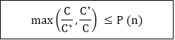
Performance Ratio
Suppose that we are working on an optimization problem in which each potential solution has a cost,
We wish to find a near-optimal solution.
Depending on the problem, we may define an optimal solution
as one with maximum possible cost or
one with minimum possible cost
the problem can either be a maximization or minimization problem.
Let C be the cost of the solution returned by an approximate algorithm, and C* is the cost of the optimal solution.
We say the approximate algorithm has an approximate ratio P (n) for an input size n, where

Slide 9
Performance Ratio
If an algorithm reaches an approximation ratio of P(n), then we call it a P(n)-approximation algorithm.
For a maximization problem, 0< C < C*, and the ratio of C*/C gives the factor by which the cost of an optimal solution is larger than the cost of the approximate algorithm.
For a minimization problem, 0< C* < C, and the ratio of C/C* gives the factor by which the cost of an approximate solution is larger than the cost of an optimal solution.

Slide 10
Performance Ratio
Intuitively, the approximation ratio measures how bad the approximate solution is distinguished with the optimal solution.
A large (small) approximation ratio measures the solution is much worse than (more or less the same as) an optimal solution.
Observe that P (n) is always ≥ 1,
if the ratio does not depend on n, we may write P.
Therefore, a 1-approximation algorithm gives an optimal solution.
Some problems have polynomial-time approximation algorithm with small constant approximate ratios, while others have best-known polynomial time approximation algorithms whose approximate ratios grow with n.

Slide 11
Minimum Vertex Cover Problem

Slide 12
Minimum Vertex Cover: Problem
A simple example of an approximation algorithm is one for the minimum vertex cover problem,
where the goal is to
Given a graph G = (V,E)
choose the smallest set of vertices such that every edge in the input graph contains at least one chosen vertex.
A Vertex Cover of a graph G is a set of vertices such that each edge in G is incident to at least one of these vertices.
The decision vertex-cover problem was proven NP-Complete.
Now, we want to solve the optimal version of the vertex cover problem, i.e., we want to find a minimum size vertex cover of a given graph. We call such vertex cover an optimal vertex cover C*.

Slide 13
Minimum Vertex Cover: Example
there is no polynomial-time solution for this unless P = NP.
There are approximate polynomial-time algorithms to solve the problem though.

Slide 14
Minimum Vertex Cover: Naïve Method
Method 1 (Naive) We can check in O(E + V) time if a given subset of vertices is a vertex cover or not, using the following algorithm.
Generate all 2^{V} subsets of vertices in graph and
do following for every subset.
1. edges_covered = 0
2. for each vertex in current subset
3. for all edges emerging out of current vertex
4. if the edge is not already marked visited
5. mark the edge visited
6. edges_covered++
7. if edges_covered is equal to total number edges
8. return size of current subset
An upper bound on time complexity of this solution is O((E + V) * 2^{V})

Slide 15
Minimum Vertex Cover: Binary Search
Method 2 (Binary Search)
If we generate 2^{V} subsets
first by generating ^{V}C_{V} subsets,
then ^{V}C_{(V-1)} subsets,
and so on upto ^{V}C₀ subsets
(2^{V} = ^{V}C_{V} + ^{V}C_{(V-1)} + ... + ^{V}C₁ + ^{V}C₀).
Our objective is now to find the minimum k such that at least one subset of size 'k' amongst ^{V}C_{k} subsets is a vertex cover
If minimum size vertex cover is of size k, then there will exist a vertex cover of all sizes more than k.
That is, there will be a vertex cover of size k + 1, k + 2, k + 3, ..., n.

Slide 16
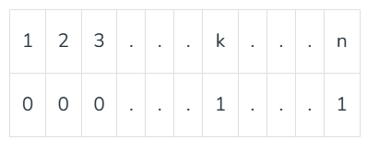
Minimum Vertex Cover: Binary Search
Imagine a Boolean array of size n and call it isCover[].
So, if the answer of the question; “Does a vertex cover of size x exist?”
If yes- put a '1' at x^{th} position,
otherwise '0'. The array isCover[] will look like:
The array is sorted and hence binary searchable,
as no index before k will have a '1’,
and every index after k(inclusive) will have a '1’,
so k is the answer.
We can apply Binary Search to find the minimum size vertex set that covers all edges
(this problem is equivalent to finding last 1 in isCover[]).

Slide 17
Gosper Hack
Now the problem is how to generate all subsets of a given size.
The idea is to use Gosper's hack.
What is Gosper's Hack?
Gosper's hack is a technique to get the next number with same number of bits set.
So, we set the first x bits from right and generate next number with x bits set until the number is less than 2^{V}. In this way, we can generate all ^{V}Cx numbers with x bits set.

Slide 18
Gosper Hack : Algorithm
The Algorithm
c = x & -x: This isolates the lowest set bit (the "rightmost" 1).
r = x + c: This clears the lowest set bit and sets the next bit to its left (if it's 0).
(((x ^ r) >> 2) / c): This calculates the bits that were "carried over" by the x + c operation and then divides by c to position them correctly.
| r: The result of the previous step is OR-ed with r to form the final output.
unsigned int gosper_hack(unsigned int x) { unsigned int c = x & -x; // Isolate the lowest set bit unsigned int r = x + c; // Move bits to the left return (((x ^ r) >> 2) / c) | r; // Combine and reposition bits }

Slide 19
Gosper Hack : Example
x = 1010 – decimal 10
c = x & -x c = 1010 & -1010 The two's complement of 1010 is 0110. c = 1010 & 0110 = 0010
r = x + c r = 1010 + 0010= 1100
y = (((x ^ r) >> 2) // c) | r (x ^ r) = 1010 ^ 1100 = 0110 ((x ^ r) >> 2) = 0110 >> 2 = 0001 (((x ^ r) >> 2) // c) = 0001 // 0010 = 0000 y = 0000 | 1100 = 1100
The next combination after 1010 is 1100, or decimal 12

Slide 20
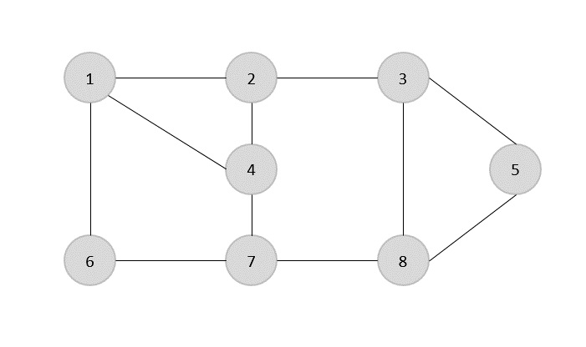

Minimum Vertex cover: Approximation
Given a following graph G = {V,E}- find the minimum vertex cover
the set of edges of the given graph is −
{(1,6),(1,2),(1,4),(2,3),(2,4),(6,7),(4,7),(7,8),(3,8),(3,5),(8,5)}
The idea is to take an edge (u, v) one by one, put both vertices to C, and remove all the edges incident to u or v. We carry on until all edges have been removed. C is a VC. But how good is C?

Slide 21
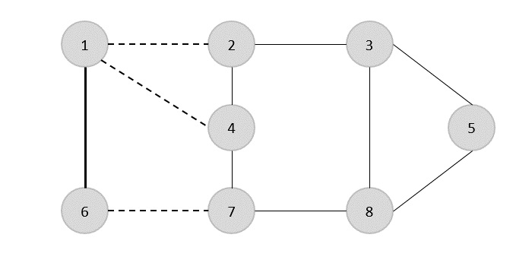
Minimum Vertex cover: Approximation
Now, we start by selecting an arbitrary edge (1,6).
We eliminate all the edges, which are either incident to vertex 1 or 6
and we add edge (1,6) to cover.

Slide 22
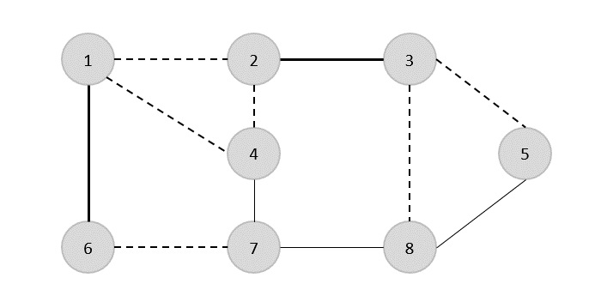
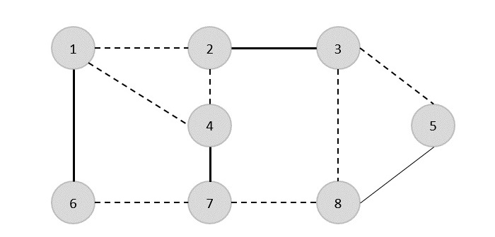
Minimum Vertex cover: Approximation
In the next step, we have chosen another edge (2,3) at random
Now we select another edge (4,7).

Slide 23
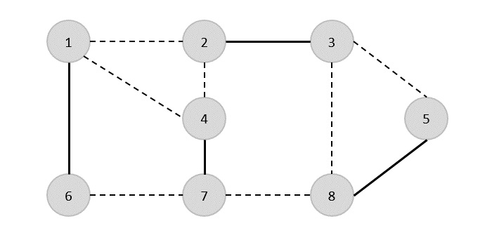
Minimum Vertex cover: Approximation
We select another edge (8,5).
Hence, the vertex cover of this graph is

Slide 24

Minimum Vertex Cover: The Approximation algorithm
Consider all the subset of vertices one by one and find out whether it covers all edges of the graph.
Using each element of this set check whether these vertices cover all the edges of the graph.
Hence update the optimal answer.
print the subset having minimum number of vertices which also covers all the edges of the graph.
1) Initialize the result as {}
2) Consider a set of all edges in given graph. Let the set be E.
3) Do following while E is not empty
...a) Pick an arbitrary edge (u, v) from set E and add 'u' and 'v' to result
...b) Remove all edges from E which are either incident on u or v.
4) Return result

Slide 25
Minimum Vertex Cover: The Approximation algorithm
Approx-Vertex-Cover (G = (V, E))
{
C = empty-set;
E'= E;
While E' is not empty do
{
Let (u, v) be any edge in E': (*)
Add u and v to C;
Remove from E' all edges incident to u or v;
}
Return C;
}

Slide 26
Analysis
How well the above algorithm perform?
It can be proved that the above approximate algorithm never finds a vertex cover whose size is more than twice the size of the minimum possible vertex cover
It is easy to see that the running time of this algorithm is O(V+E), using adjacency list to represent E`.
Theorem: APPROX-VERTEX-COVER is a polynomial-time 2-approximate algorithm i.e., the algorithm has a ratio bound of 2.
Goal: Since this a minimization problem, we are interested in smallest possible c/c*.
Specifically, we want to show c/c* ≤ 2 = p(n).
In other words, we want to show that APPROX-VERTEX-COVER algorithm returns a vertex-cover that is at most twice the size of an optimal cover.

Slide 27
Proof: Let the set c and c* be the sets output by APPROX-VERTEX-COVER and OPTIMAL-VERTEX-COVER respectively. Also, let A be the set of edges selected .
Because, we have added both vertices, we get c = 2|A|
but OPTIMAL-VERTEX-COVER would have add one of two.
=> c/c* ≤ p(n) = 2.
Formally, since no two edge in A are covered by the same vertex from c*
(since, once an edge is picked in line 4, all other edges that are incident on its endpoints are deleted from E` in line 6)
and we have the lower bound:
|c*| ≥ A ---------------------------------- 1
On the size of an OPTIMAL-VERTEX-COVER.
we picked both end points yielding an upper bound on the size of Vertex-Cover.
|c| ≤ 2|A|

Slide 28
Since, upper bound is an exact in this case, we have
|c| = 2|A| ---------------------------------- 2 Take |c|/2 = |A| and put it in equation 1 |c*| ≥ |c|/2
|c*|/|c| ≥ ½
|c|/|c*| ≤ 2 = p(n)
Hence proved

Slide 29

TSP Metric

Slide 30
Introduction
Travelling Salesman Problem used Naive and Dynamic Programming Solutions.
Both of the solutions are infeasible.
In fact, there is no polynomial time solution available for this problem as the problem is a known NP-Hard problem. There are approximate algorithms to solve the problem though.
The approximate algorithms work only if the problem instance satisfies Triangle-Inequality.
Triangle-Inequality:
The least distant path to reach a vertex j from i is always to reach j directly from i, rather than through some other vertex k (or vertices),
i.e., dis(i, j) is always less than or equal to dis(i, k) + dist(k, j).
The Triangle-Inequality holds in many practical situations.
When the cost function satisfies the triangle inequality, we can design an approximate algorithm for TSP that returns a tour whose cost is never more than twice the cost of an optimal tour.
The idea is to use Minimum Spanning Tree (MST).

Slide 31
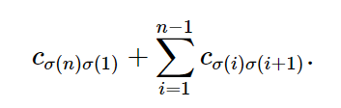

Proposed Approximation
Given a list of cities and the distances between each pair of cities, what is the shortest possible route that visits each city and returns to the origin city?
Formally, for a set of cities [n]={1,2,…,n}
, an n x n matrix C=(c_{ij}),
where cij≥0 specifies the cost of traveling from city i to city j
. By convention, we assume c_{ii}=0 and c_{ij}=c_{ji}
, meaning that the cost of traveling from city I to city j = the cost of traveling from city j to city i
. Furthermore, we only consider the metric TSP; that is, the triangle inequality holds for any i,j,k
c_{ik} ≤ c_{ij} + c_{jk,} ∀i,j,k∈[n].
Given a permutation σ of [n]
, a tour traverses the cities in the order σ(1),σ(2),…,σ(n)
. The goal is to find a tour with the lowest cost, which is equal to

Slide 32
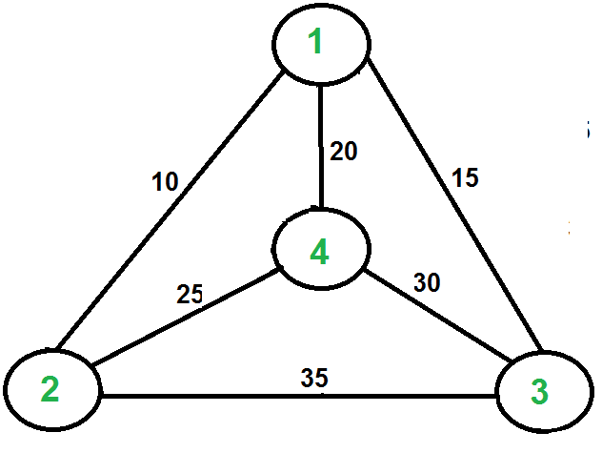
Proposed Approximation
Let 1 be the starting and ending point for salesman.
Construct MST from with 1 as root using Prim’s Algorithm.
List vertices visited in preorder walk of the constructed MST and add 1 at the end.
Consider the following example.
The first diagram is the given graph.

Slide 33
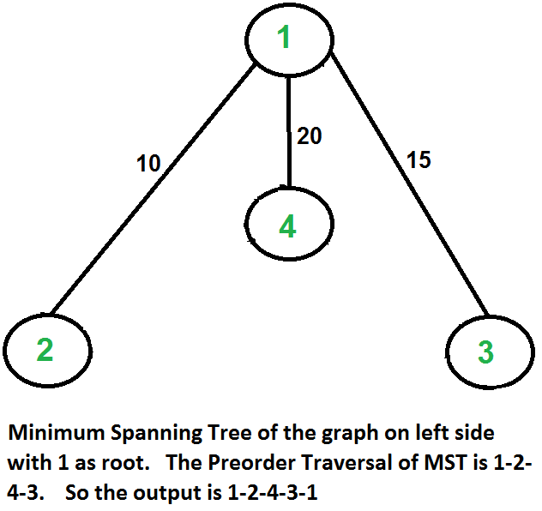
Proposed Approximation
The second diagram shows MST constructed with 1 as root.
The preorder traversal of MST is 1-2-4-3.
Adding 1 at the end gives 1-2-4-3-1 which is the output of this algorithm.
In this case, the approximate algorithm produces the optimal tour, but it may not produce optimal tour in all cases.

Slide 34
Algorithm
Step 1 − Choose any vertex of the given graph randomly as the starting and ending point.
Step 2 − Construct a minimum spanning tree of the graph with the vertex chosen as the root using prim’s algorithm.
Step 3 − Once the spanning tree is constructed, pre-order traversal is performed on the minimum spanning tree obtained in the previous step.
Step 4 − The pre-order solution obtained is the Hamiltonian path of the travelling salesperson.
APPROX_TSP(G, c)
r <- root node of the minimum spanning tree T <- MST_Prim(G, c, r)
visited = {ф}
for i in range V:
H <- Preorder_Traversal(G)
visited = {H}

Slide 35
How is this algorithm 2-approximate?
The cost of the output produced by the above algorithm is never more than twice the cost of best possible output. Let us see how is this guaranteed by the above algorithm.
Let us define a term full walk to understand this.
A full walk lists all vertices when they are first visited in preorder,
it also lists vertices when they are returned after a subtree is visited in preorder.
The full walk of above tree would be 1-2-1-4-1-3-1.
The cost of best possible Travelling Salesman tour is never less than the cost of MST. (The definition of MST says, it is a minimum cost tree that connects all vertices).
The total cost of full walk is at most twice the cost of MST (Every edge of MST is visited at-most twice).
The output of the above algorithm is less than the cost of full walk.
In above algorithm, we print preorder walk as output.
In preorder walk, two or more edges of full walk are replaced with a single edge. For example, 2-1 and 1-4 are replaced by 1 edge 2-4.
So, if the graph follows triangle inequality, then this is always true.
From the above statements, we can conclude that the cost of output produced by the approximate algorithm is never more than twice the cost of best possible solution.

Slide 36
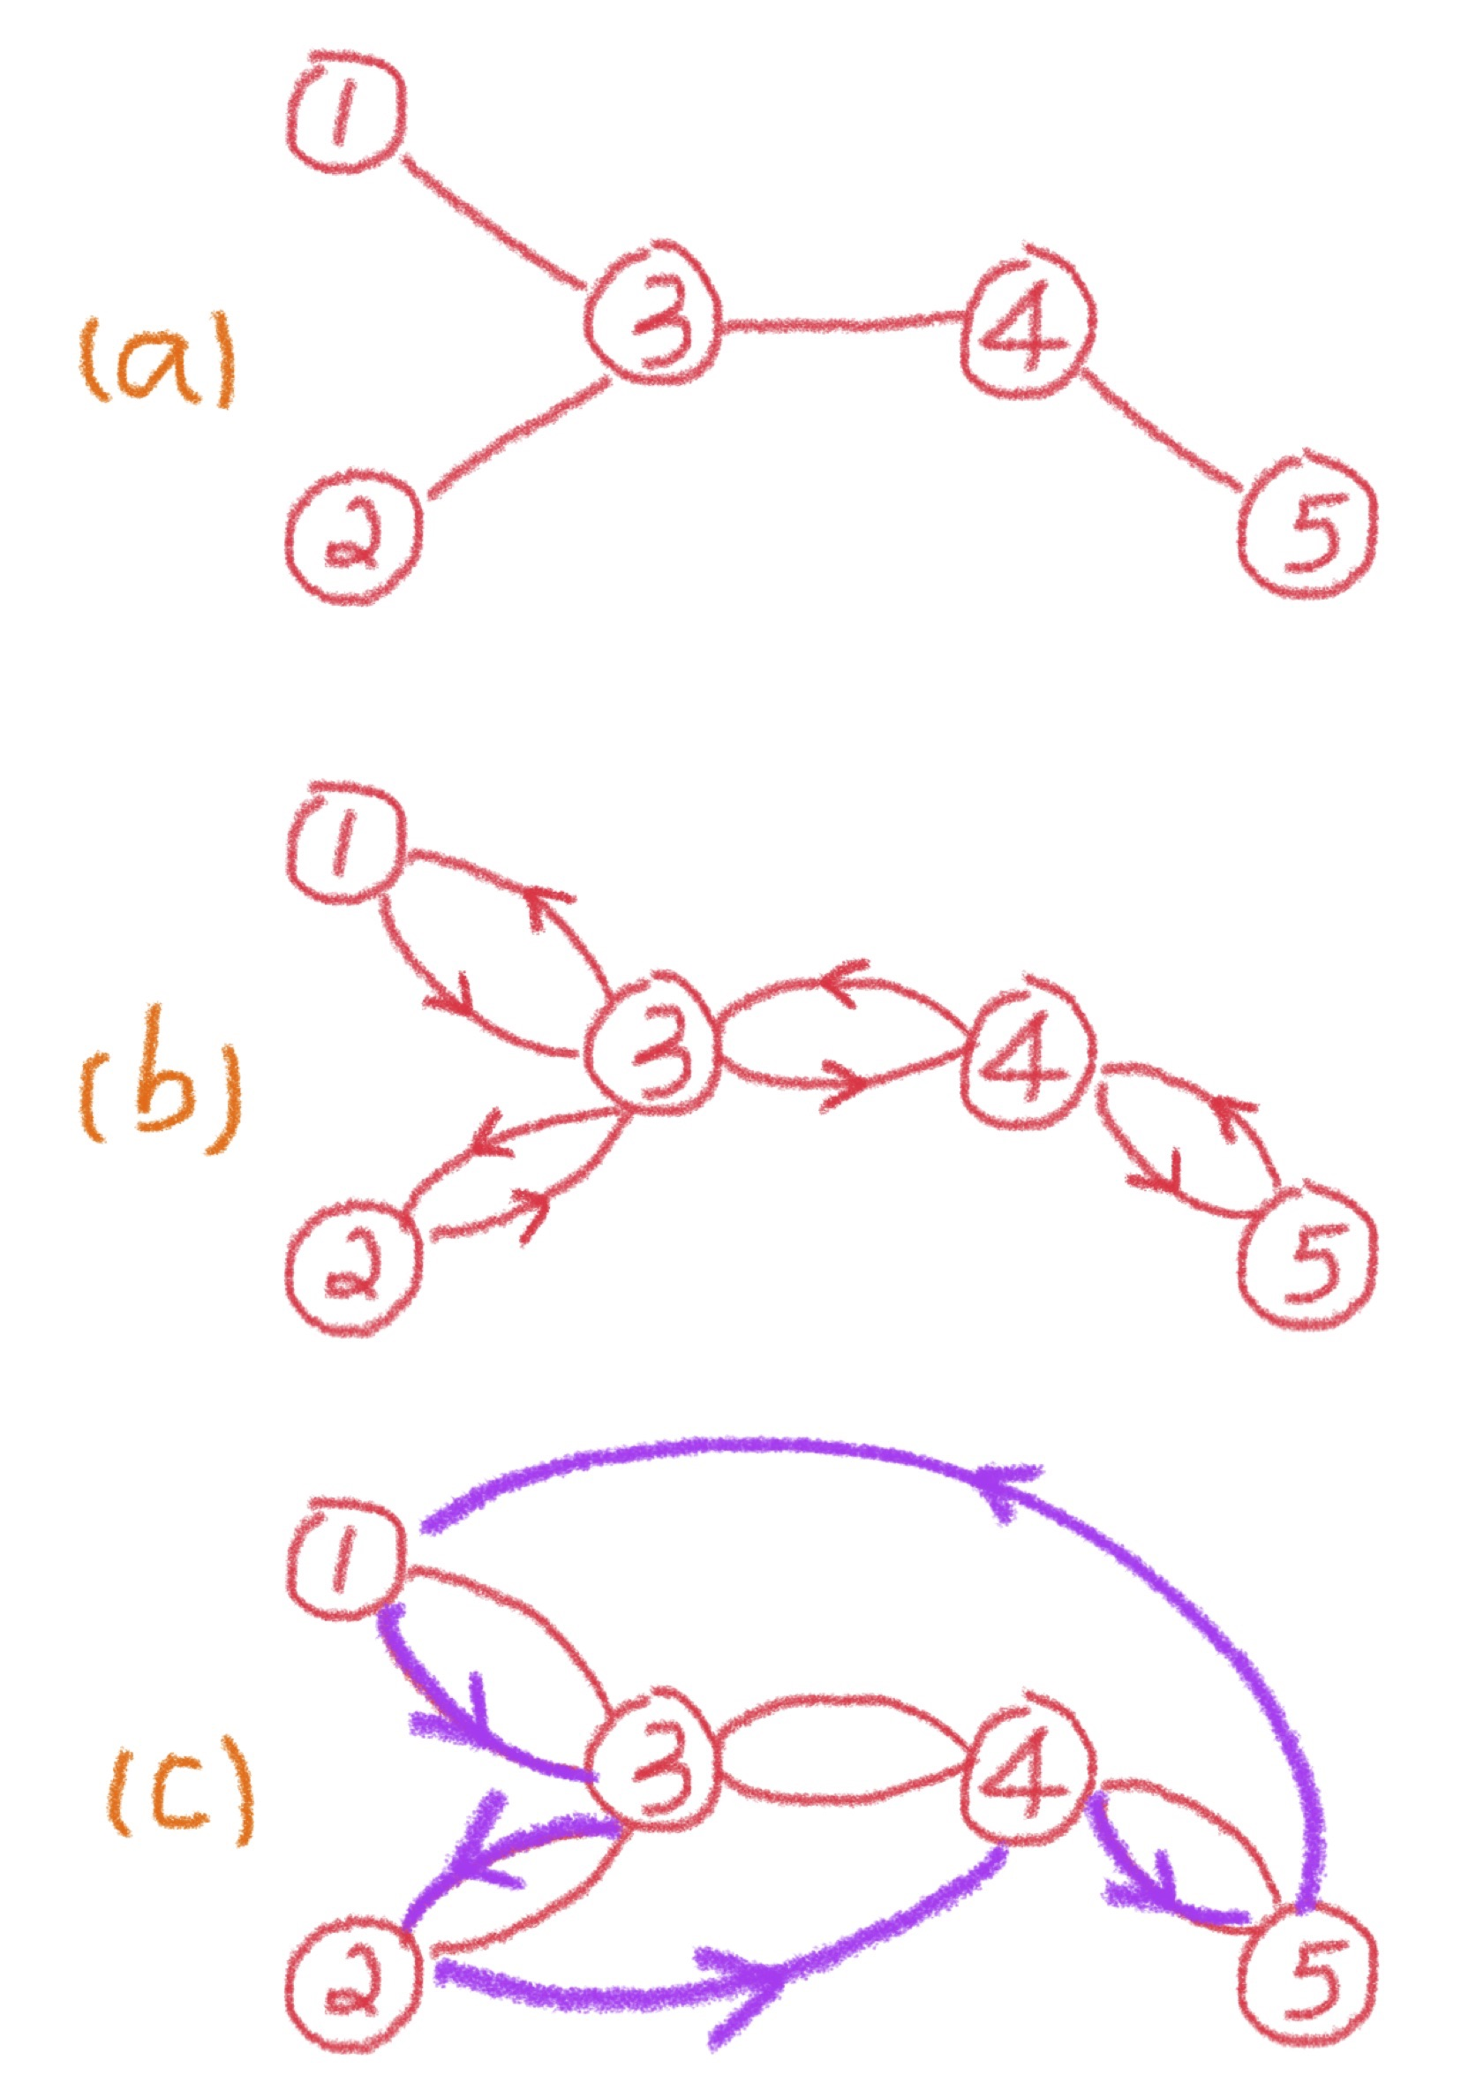
Figure shows the algorithm on a simple five-city instance.
A step-by-step explanation of the algorithm is as follows:

Slide 37
Analysis
A spanning tree of an undirected graph is a subgraph that is a tree
and includes all of the nodes.
A minimum spanning tree of a weighted graph is a spanning tree for which the total edge cost is minimized. There are several polynomial-time algorithms for finding a minimum spanning tree, e.g., Prim’s algorithm, Kruskal’s algorithm, and the reverse-delete algorithm.
Figure a shows a minimum spanning tree T
.
Next, each edge in the minimum spanning tree is replaced by two copies of itself, as shown in Figure b. The resulting (multi)graph is Eulerian. A graph is said to be Eulerian if there exists a tour that visits every edge exactly once.
A graph is Eulerian if and only if it is connected and each node has an even degree.
Given a Eulerian graph, it is easy to construct a traversal of the edges.
For example, a possible Eulerian tour in Figure b is 1–3–2–3–4–5–4–3–1.
Moreover, since the edges are duplicated from the minimum spanning tree, the Eulerian tour has cost at most 2,OPT
.

Slide 38
Analysis
Finally, given the Eulerian tour, we remove all but the first occurrence of each node in the sequence;
this step is called shortcutting.
By the triangle inequality, the cost of the shortcut tour is at most the cost of the Eulerian tour, which is not greater than 2,OPT
.In Figure c, the shortcut tour is 1–3–2–4–5–1. When going from node 2 to node 4 by omitting node 3,
we have c24 ≤ c23+c34
. Similarly, when skipping nodes 4 and 3, c51 ≤ c54+c43+c31
.
The double-tree algorithm for the metric traveling salesman problem is a 2-approximation algorithm.

Slide 39
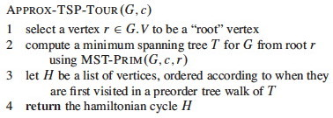

Slide 40
Nearest Neighbor Method for TSP
Nearest Neighbor Algorithm
(Rosenkrantz, Stearns, Lewis, 1974)
Step 1. Start with any node as the beginning node
Step 2. Find the unvisited node closest to the last node added to the path. Add this node to the path
.
Step 3. Repeat Step 2 until all nodes are contained in the path. Then join the first and last nodes.
The TC of nearest neighbor algorithm is

Slide 41
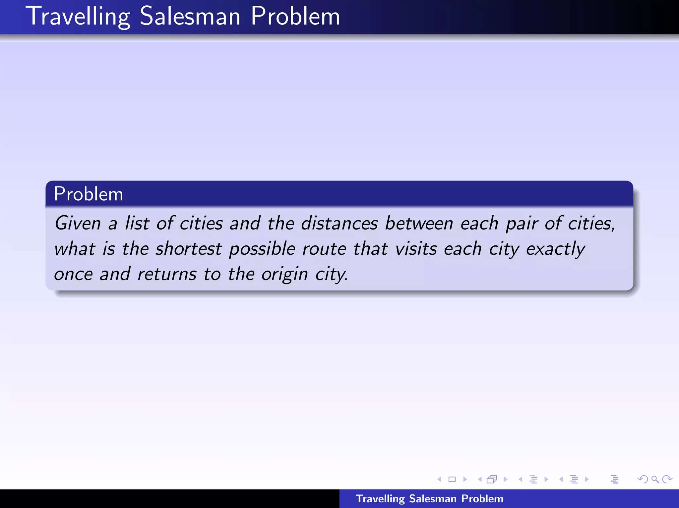

Slide 42
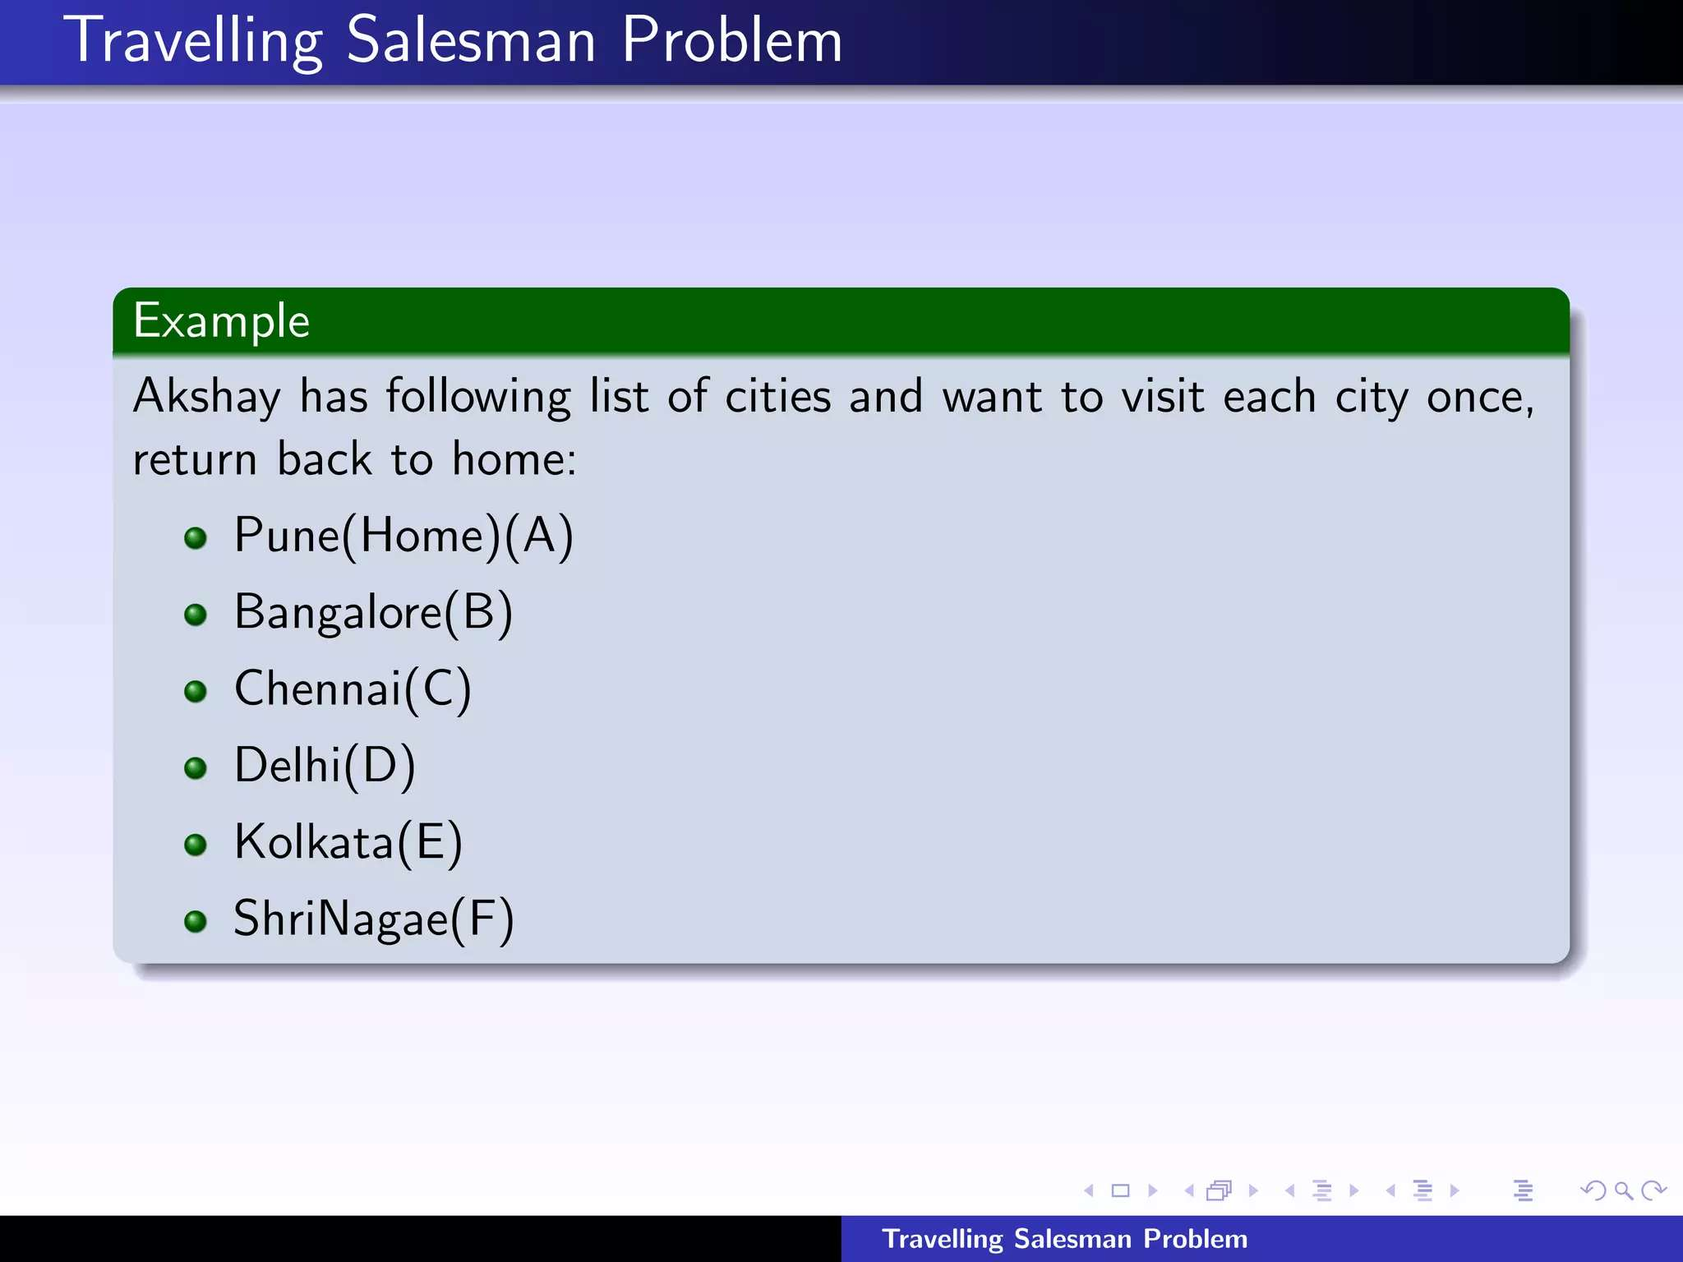

Slide 43
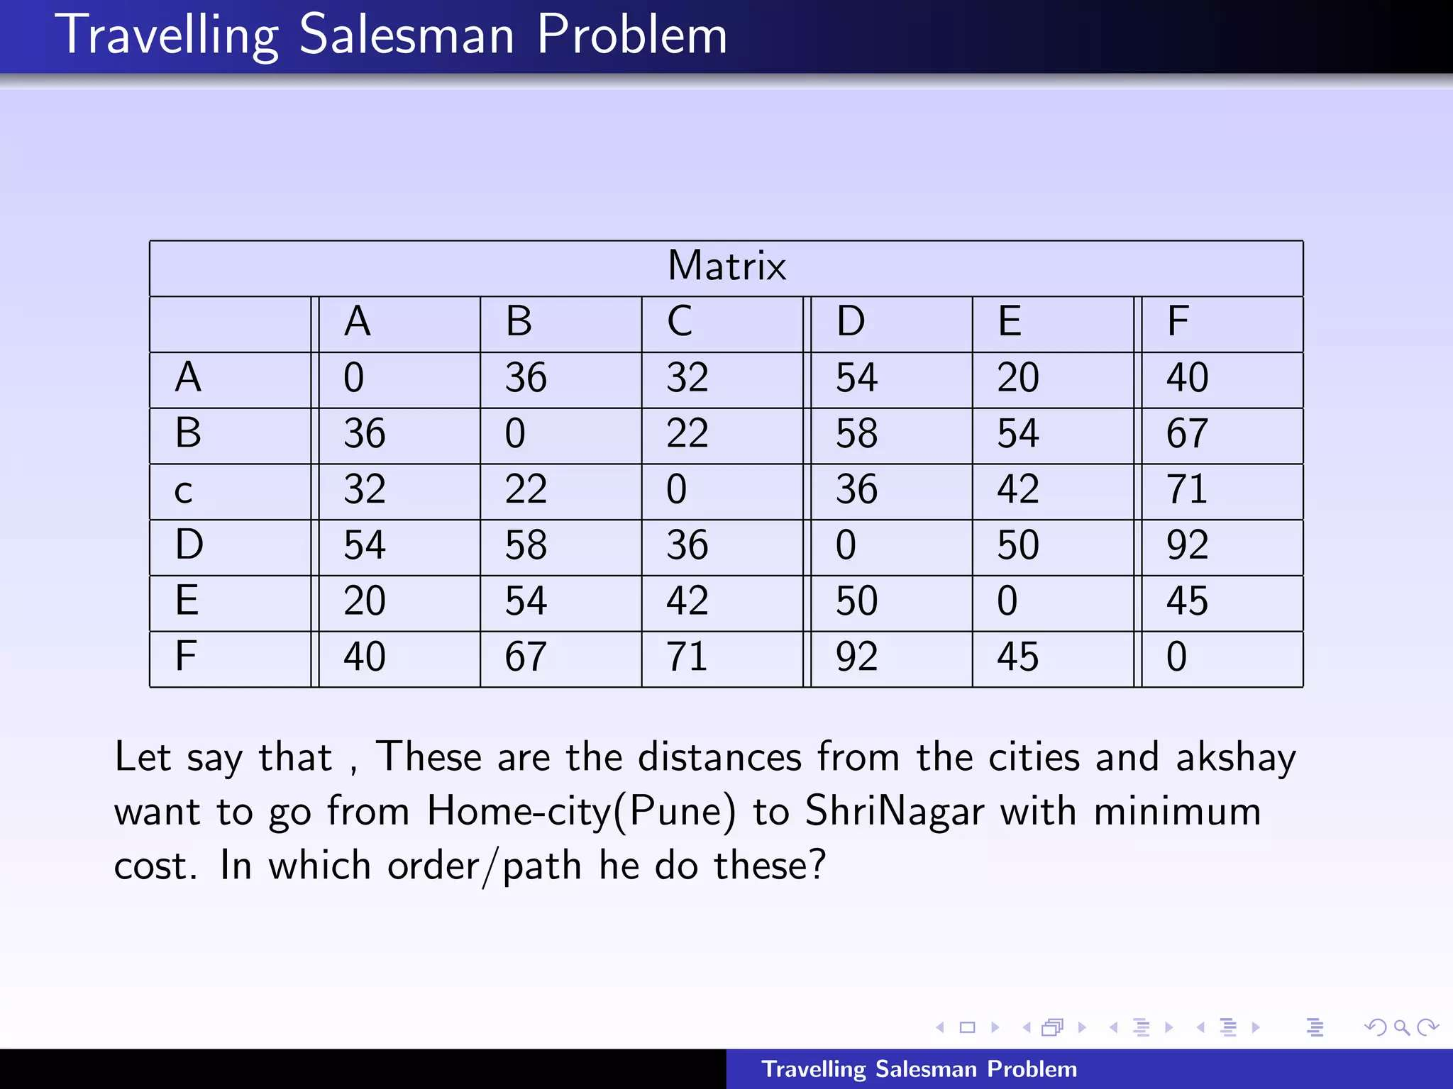

Slide 44
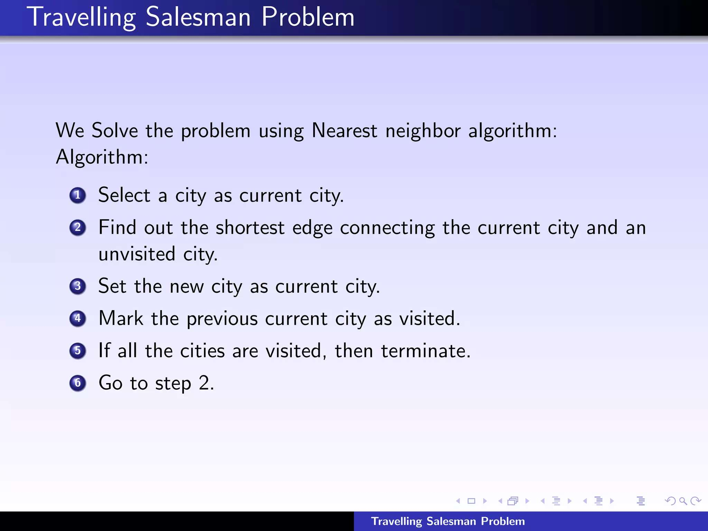

Slide 45
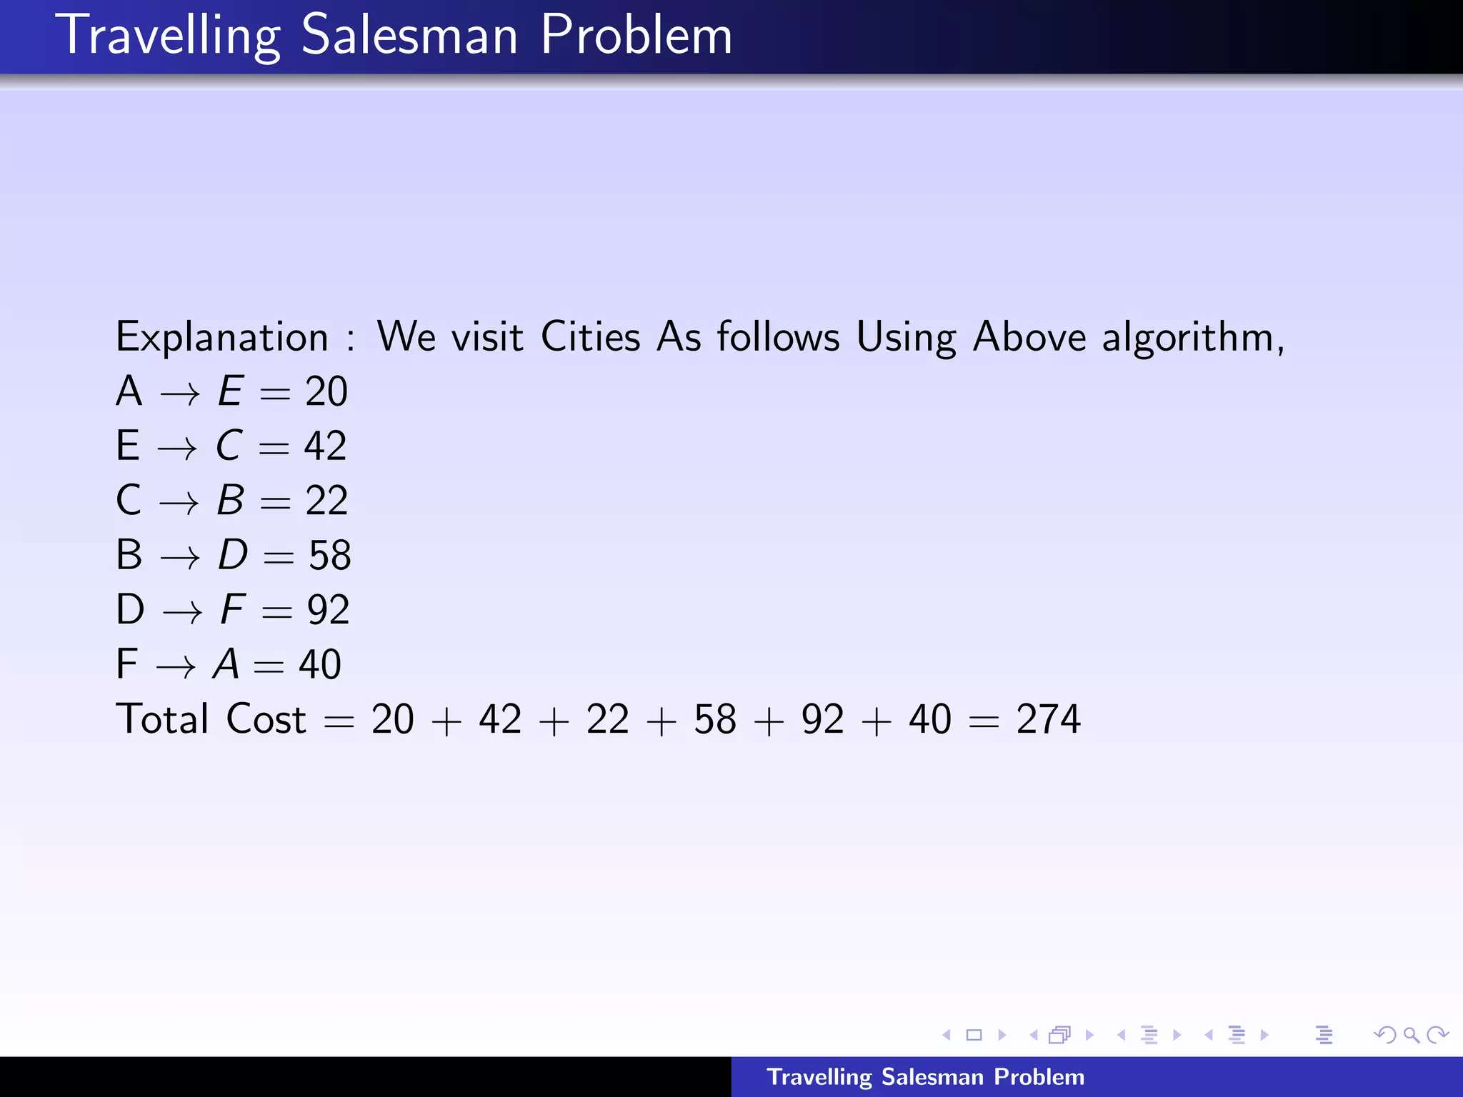

Slide 46
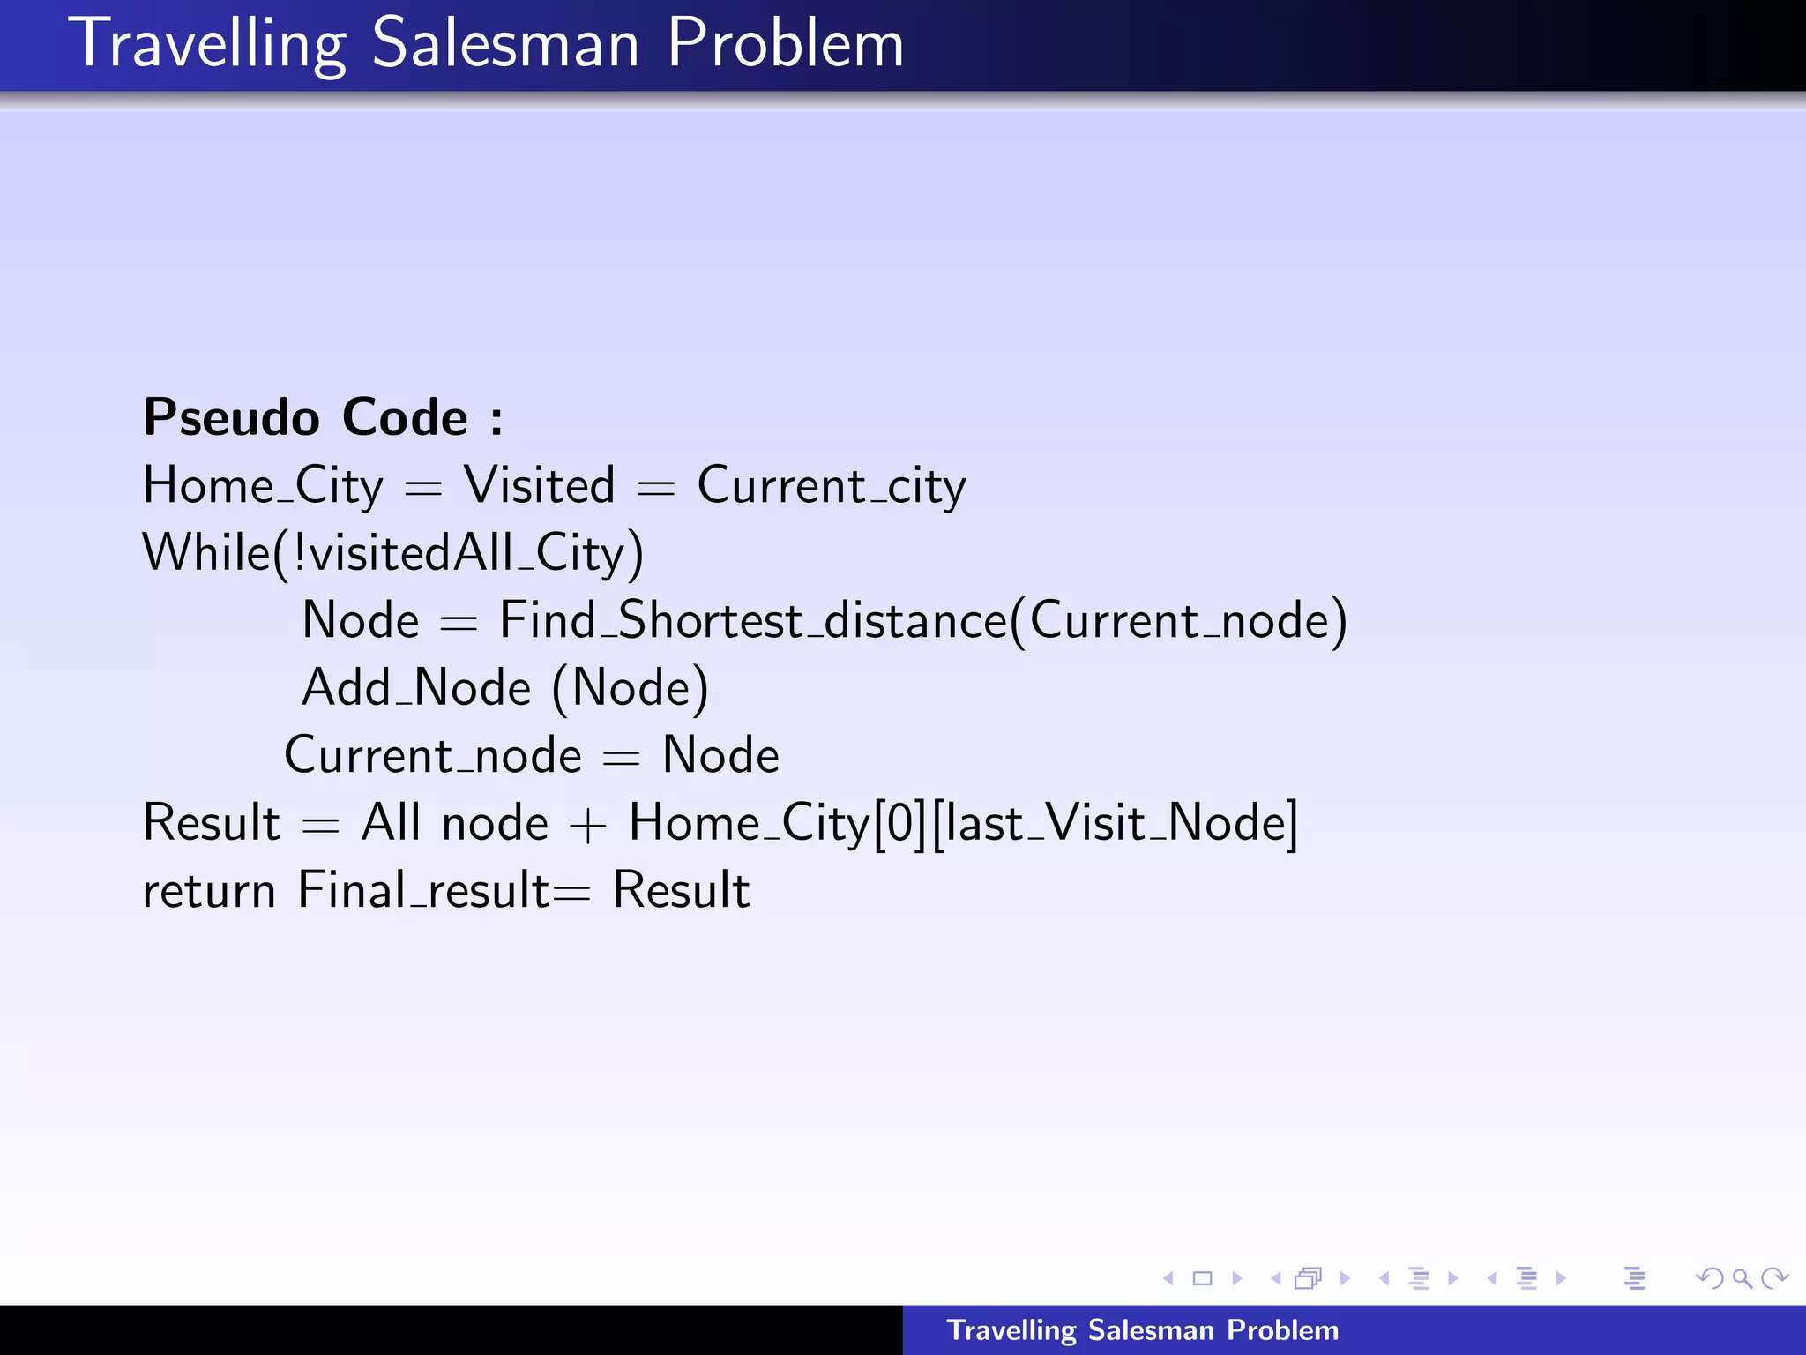

Slide 47
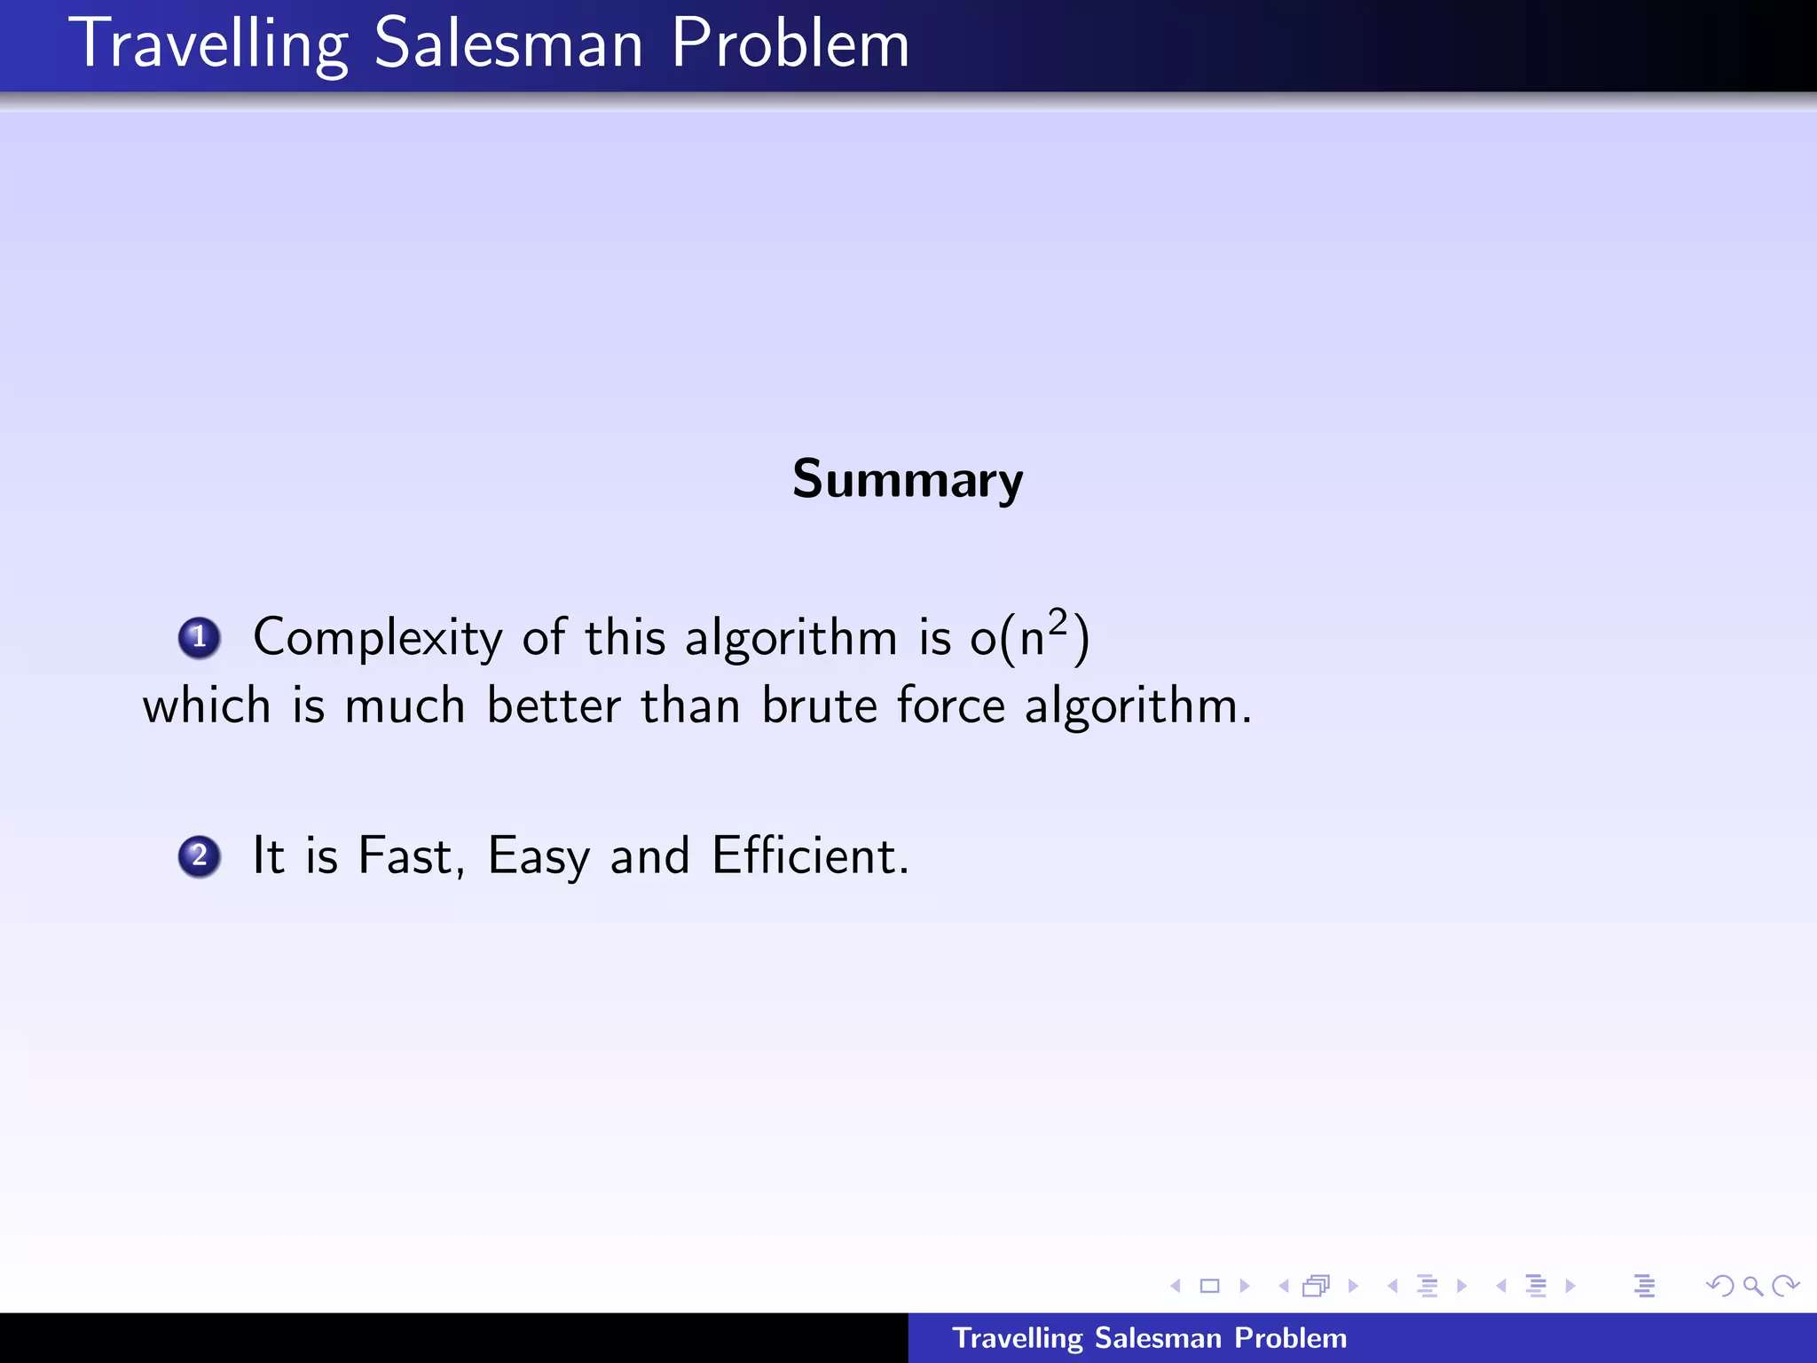

Slide 48
Approximation Scheme
An approximation scheme is a parameterized approximation algorithm that takes an additional input ε > 0 and for any fixed ε is a (1+ε)-approximation algorithm.
ε is how much slack you will allow away from the optimal 1-"approximation".
For example, if ε = 1 we have a 2-approximation scheme.
An approximation scheme is a polynomial approximation scheme if for any fixed ε > 0 the scheme runs in time polynomial in input size n.

Slide 49
Thank You

